Slide 1
VQE (Variational Quantum Eigensolver)
2014
15/5/2021

Slide 2
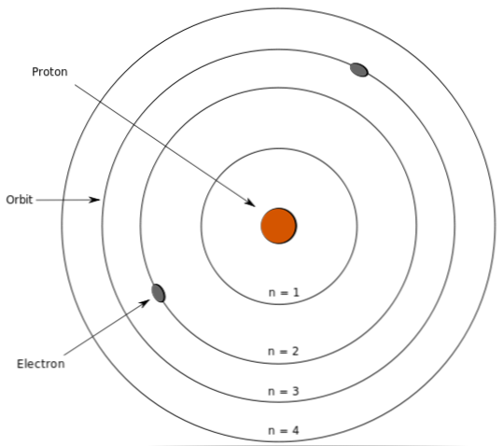
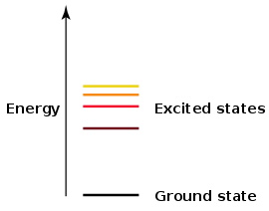
Background
Excited state
Treated as Hermitian matrix

Slide 3
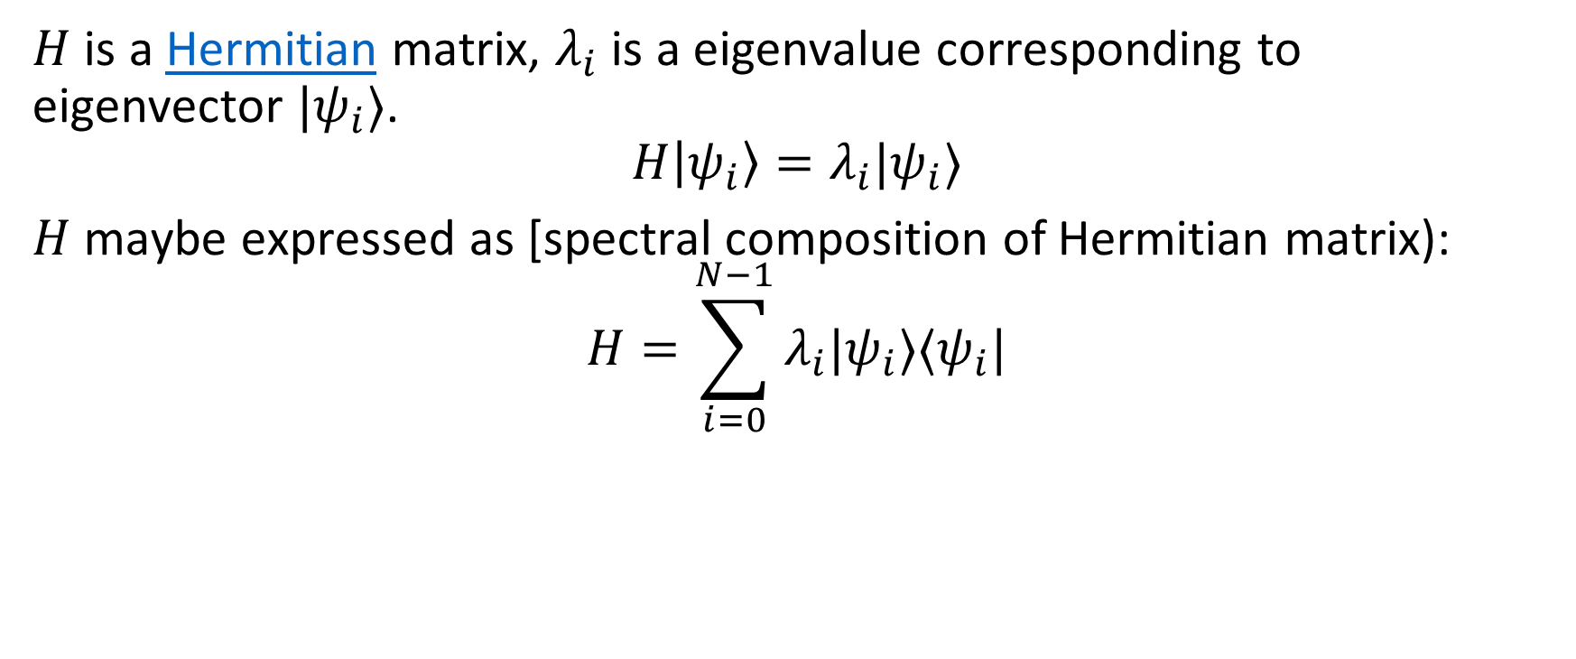
Background
$H$ is a Hermitian matrix, $λ_{i}$ is a eigenvalue corresponding to eigenvector $|ψ_{i}⟩$. $$H\left|ψ_{i}\right\rangle =λ_{i}|ψ_{i}⟩$$
$H$ maybe expressed as [spectral composition of Hermitian matrix):
$$H=\sum_{i=0}^{N−1}{λ_{i}|ψ_{i}⟩⟨ψ_{i}|}$$

Slide 4
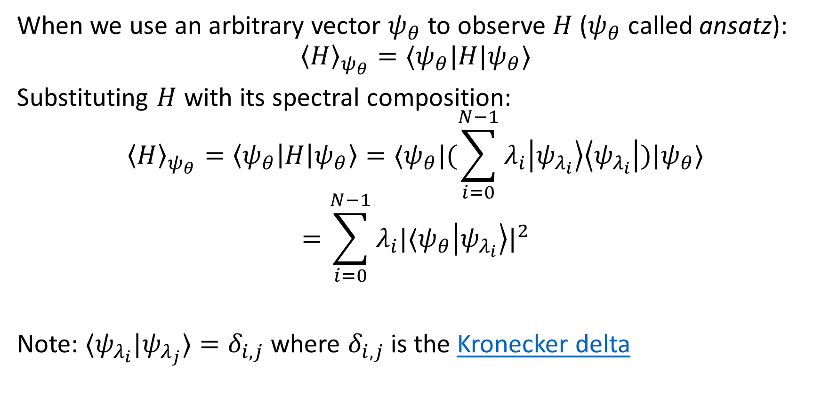
Background
When we use an arbitrary vector $ψ_{θ}$to observe $H$ ($ψ_{θ}$called ansatz): $${\left\langle H\right\rangle }_{ψ_{θ}}=⟨ψ_{θ}|H|ψ_{θ}⟩$$
Substituting $H$ with its spectral composition:
$${\left\langle H\right\rangle }_{ψ_{θ}}=\left\langle ψ_{θ}\left|H\right|ψ_{θ}\right\rangle =⟨ψ_{θ}|(\sum_{i=0}^{N−1}{λ_{i}\left|ψ_{λ_{i}}\right\rangle \left\langle ψ_{λ_{i}}\right|})|ψ_{θ}⟩$$
$$=\sum_{i=0}^{N−1}{λ_{i}|⟨ψ_{θ}{\left|ψ_{λ_{i}}\right\rangle |}^{2}}$$
Note: $⟨ψ_{λ_{i}}|ψ_{λ_{j}}⟩=δ_{i,j}$ where $δ_{i,j}$is the Kronecker delta

Slide 5
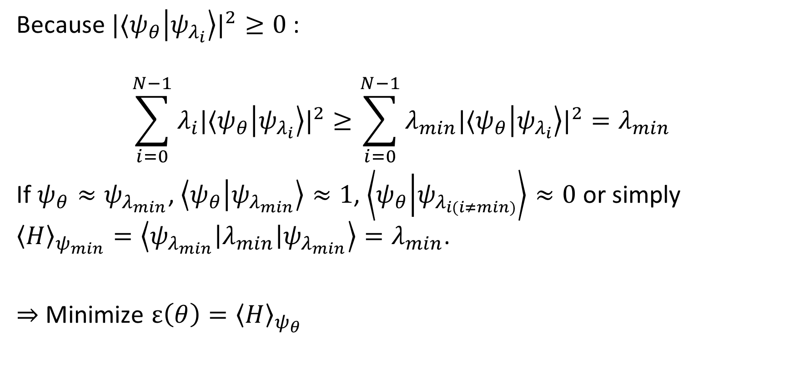
Variational method
Because $|⟨ψ_{θ}{\left|ψ_{λ_{i}}\right\rangle |}^{2}≥0$:
$$\sum_{i=0}^{N−1}{λ_{i}|⟨ψ_{θ}{\left|ψ_{λ_{i}}\right\rangle |}^{2}}≥\sum_{i=0}^{N−1}{λ_{min}|⟨ψ_{θ}{\left|ψ_{λ_{i}}\right\rangle |}^{2}}=λ_{min}$$
If $ψ_{θ}≈ψ_{λ_{min}}$, $\left\langle ψ_{θ} | ψ_{λ_{min}}\right\rangle ≈1$, $\left\langle ψ_{θ} | ψ_{λ_{i(i≠min)}}\right\rangle ≈0$ or simply ${\left\langle H\right\rangle }_{ψ_{min}}=\left\langle ψ_{λ_{min}}\left|λ_{min}\right|ψ_{λ_{min}}\right\rangle =λ_{min}$.
$⇒$ Minimize $ε\left(θ\right)={\left\langle H\right\rangle }_{ψ_{θ}}$

Slide 6


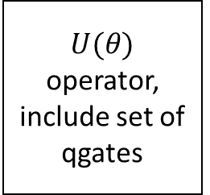



Variational Form
Like neural network ‘s function
Quantum computer
$U(θ)$ operator, include set of qgates
$$|ψ_{θ}⟩$$
$$|ψ⟩$$
$$M$$
$$ε\left(θ\right)$$
Classical computer
Update $θ$
Optimizer
Based on Mahattan or fidelity (inner product) metrics

Slide 7
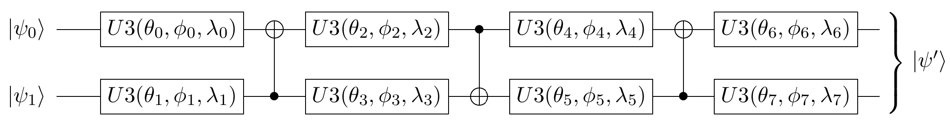
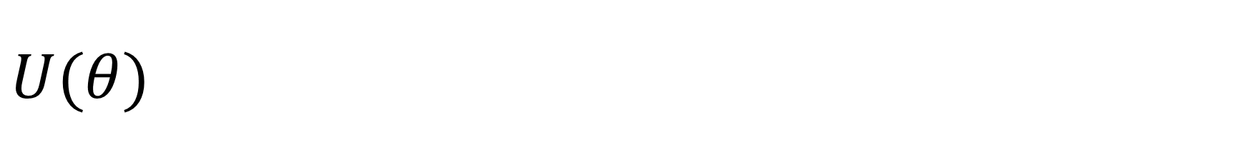
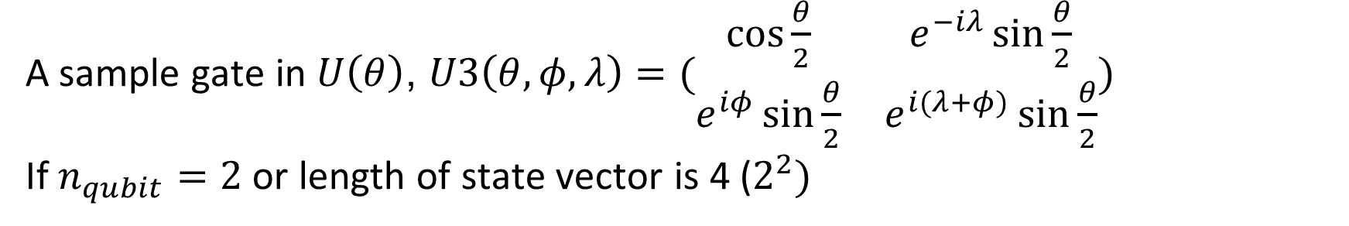
$$U(θ)$$
A sample gate in $U\left(θ\right)$, $U3\left(θ,φ,λ\right)=(\begin{matrix}\cos{\frac{θ}{2}} & e^{−iλ}\sin{\frac{θ}{2}} \\ e^{iφ}\sin{\frac{θ}{2}} & e^{i(λ+φ)}\sin{\frac{θ}{2}}\end{matrix})$
If $n_{qubit}=2$ or length of state vector is 4 ($2^{2})$

Slide 8
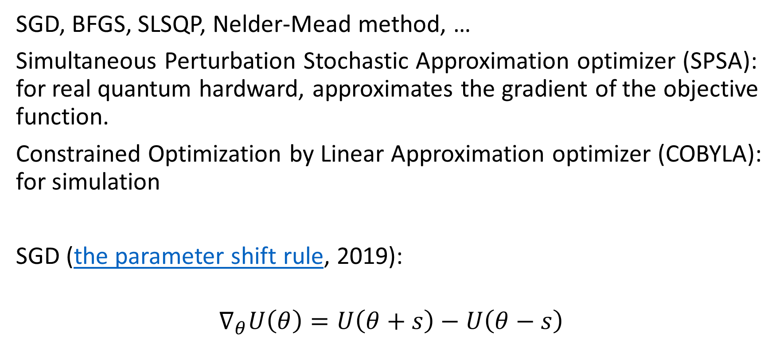
Optimizer
SGD, BFGS, SLSQP, Nelder-Mead method, …
Simultaneous Perturbation Stochastic Approximation optimizer (SPSA): for real quantum hardward, approximates the gradient of the objective function.
Constrained Optimization by Linear Approximation optimizer (COBYLA): for simulation
SGD (the parameter shift rule, 2019):
$$∇_{θ}U\left(θ\right)=U\left(θ+s\right)−U\left(θ−s\right)$$

Slide 9

Application of VQE
Simulate molecule like $LiH$, $H_{2}$, …
Quantum neural network: QRNN (2020), QuGAN(2020), QLSTM (2020), …

Slide 10
References
https://qiskit.org/textbook/ch-applications/vqe-molecules.html

